Slide 1


FEMALE LABOUR FORCE PARTICIPATION
MAYANK TOMAR
2K19-MC-070

Slide 2
ABSTRACT /ObJective

Slide 3
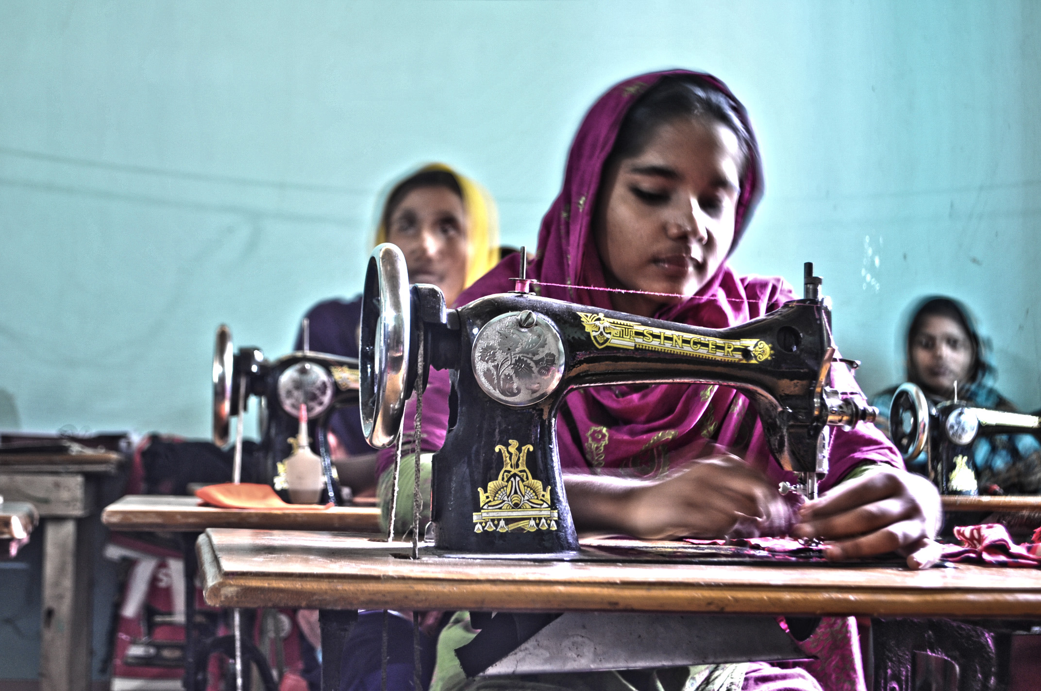
TITLE :- FEMALE LABOUR FORCE PARTICIPATION IN THE WORLD
In almost every country in the world, men are more likely to participate in labor markets than women. However, these gender differences in participation rates have been narrowing substantially in recent decades. In the slides , we discuss how and why these changes are taking place through Statistics .
Before we move on to the details, here is a preview of the main points:
In most countries men tend to participate in labor markets more frequently than women.
All over the world, labor force participation among women of working age increased substantially in the last century.
In some parts of the world, the historical increase in female labor force participation has slowed down or even regressed slightly in recent years.
Women all over the world allocate a substantial amount of time to activities that are not typically recorded as ‘economic activities’. Hence, female participation in labor markets tends to increase when the time-cost of unpaid care work is reduced, shared equally with men, and/or made more compatible with market work.

Slide 4

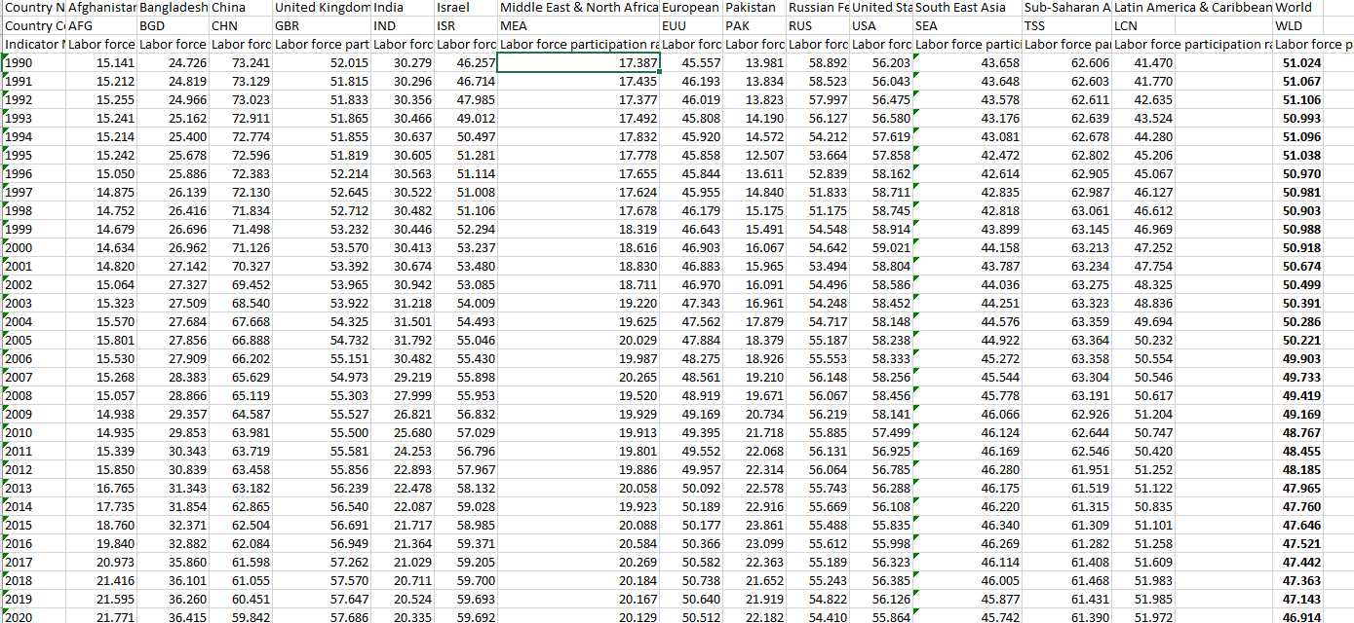
DATA OF FEMALE LABOUR FORCE PARTICIPATION

Slide 5


Formula Used = Mean + Variance +
Standard . Deviation + Median + Correlation + Linear Regression + Hypothesis .
Graph Used :- Bar chart + Histogram+ Pie Chart + Scatter Plot

Slide 6
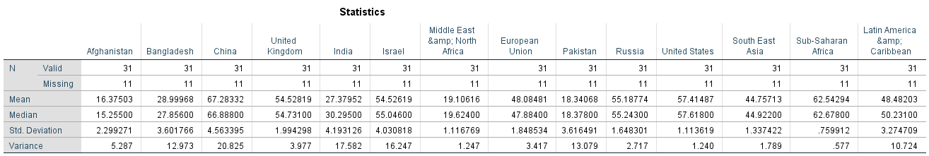

Slide 7
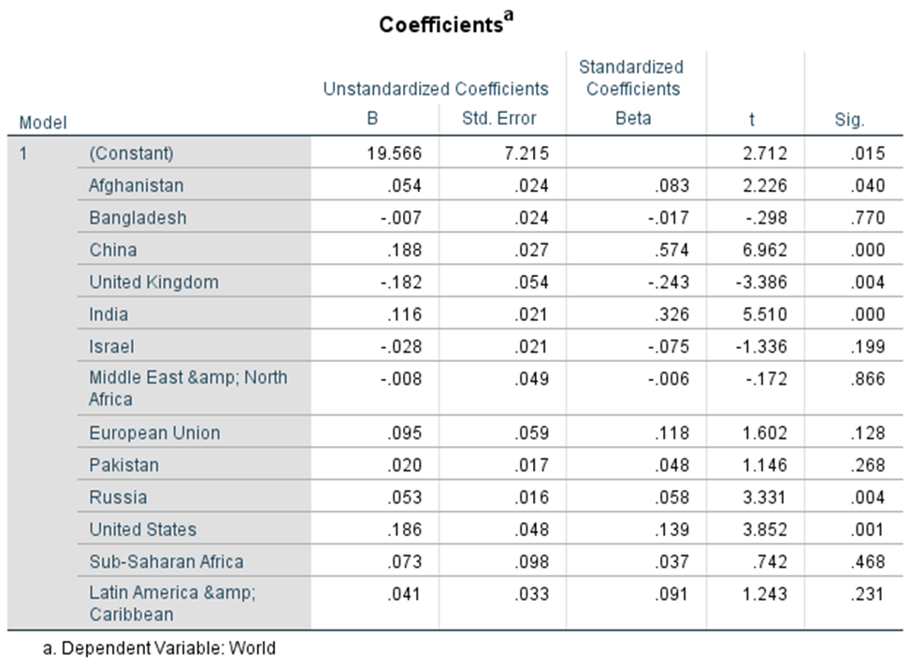
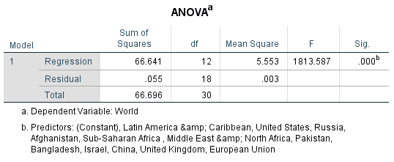
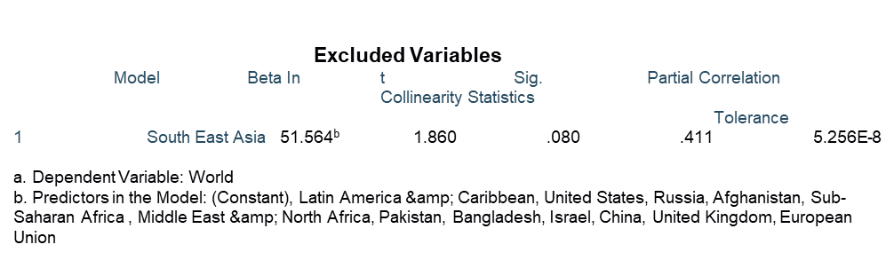
Regression
Model Summary
Model R R Square Adjusted R Square Std. Error of the Estimate
1 1.000ª .999 .999 .055336
a. Predictors: (Constant), Latin America &amp; Caribbean, United States, Russia, Afghanistan, Sub-Saharan Africa , Middle East &amp; North Africa, Pakistan, Bangladesh, Israel, China, United Kingdom, European Union

Slide 8

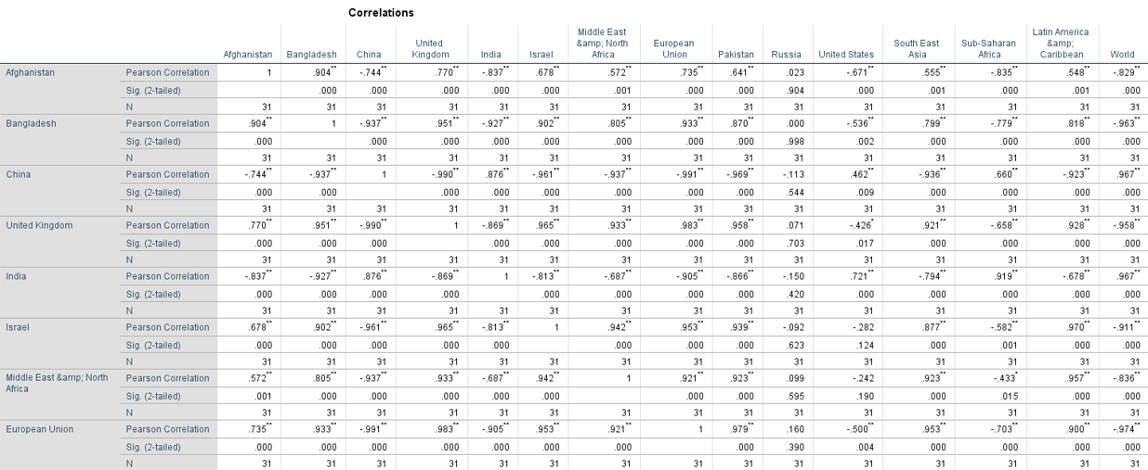
Correlation (by lab method)

Slide 10
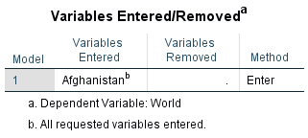
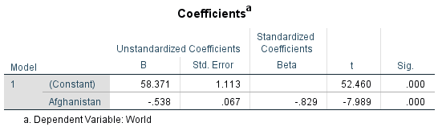
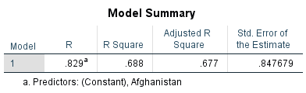
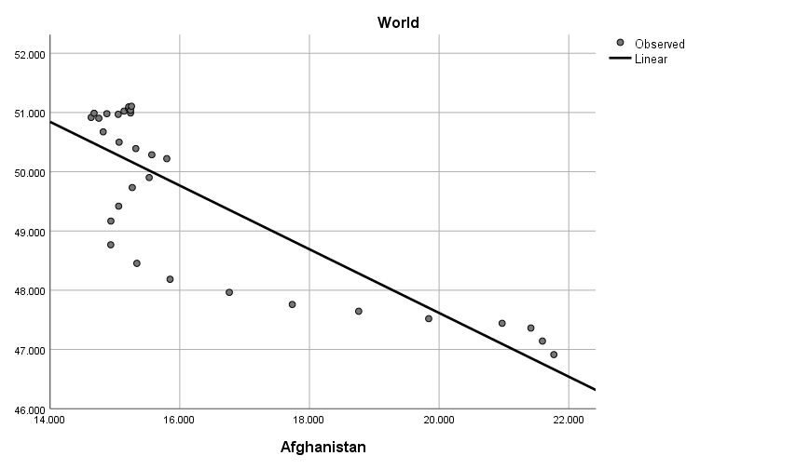
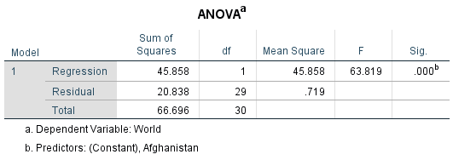
Regression by taking Afghanistan as independent And World as Dependent

Slide 11

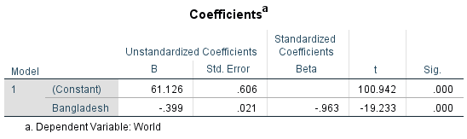

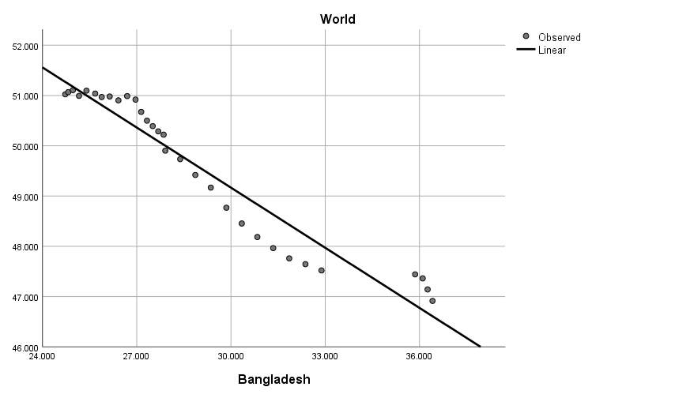


Slide 12
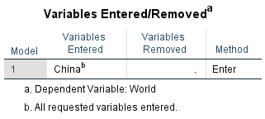
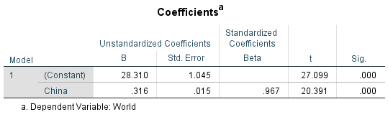
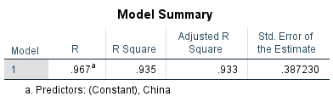
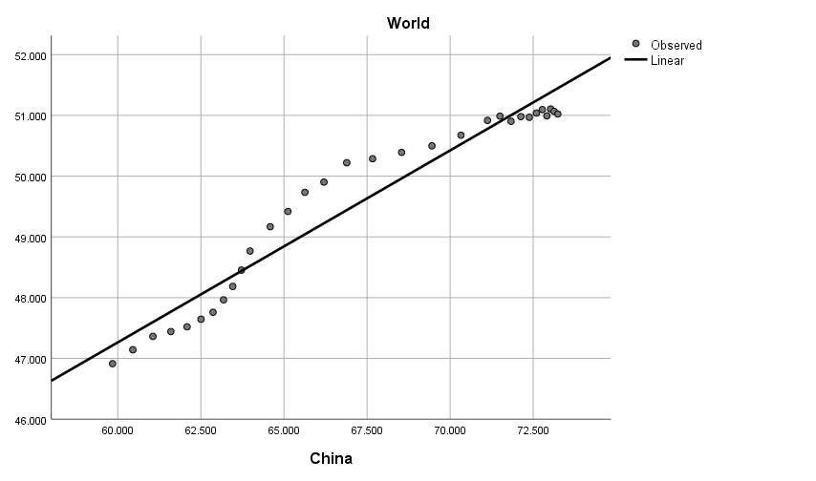


Slide 13
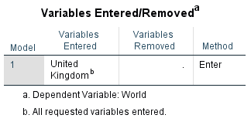
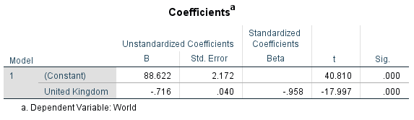
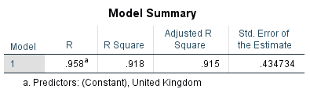
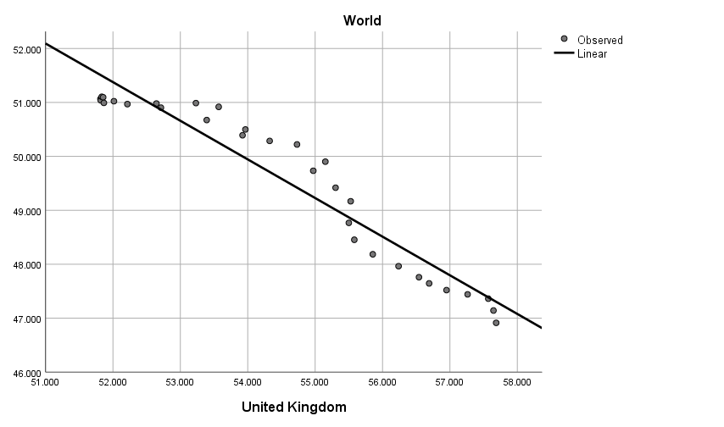
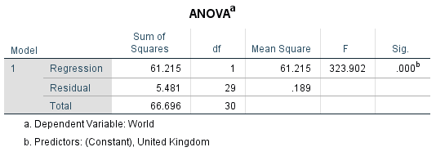

Slide 14
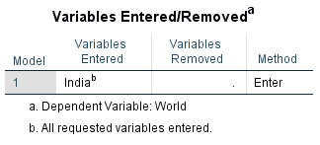
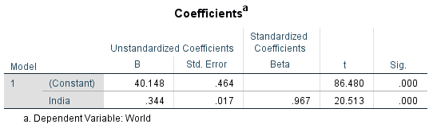
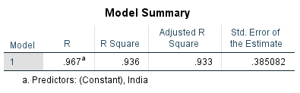
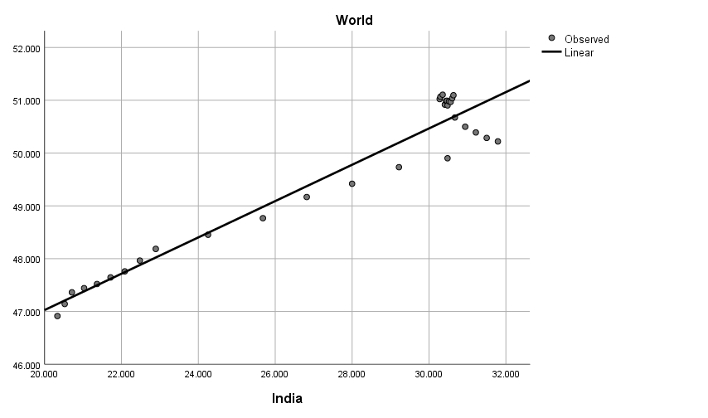
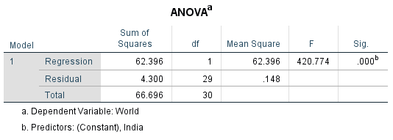

Slide 15

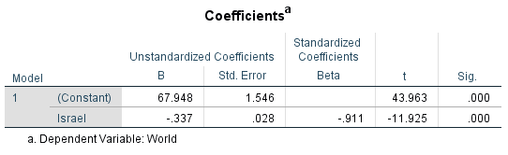
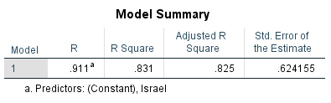
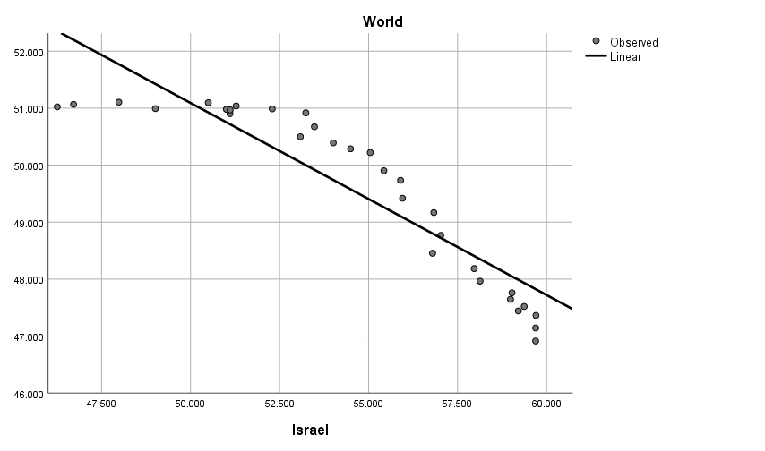
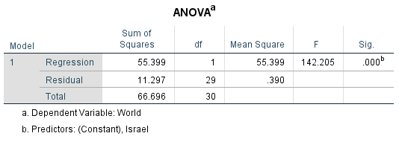

Slide 16
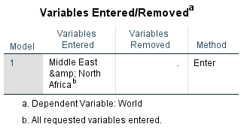
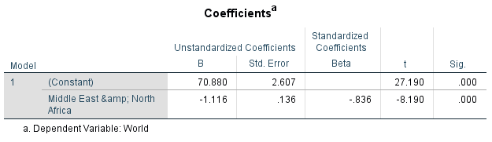
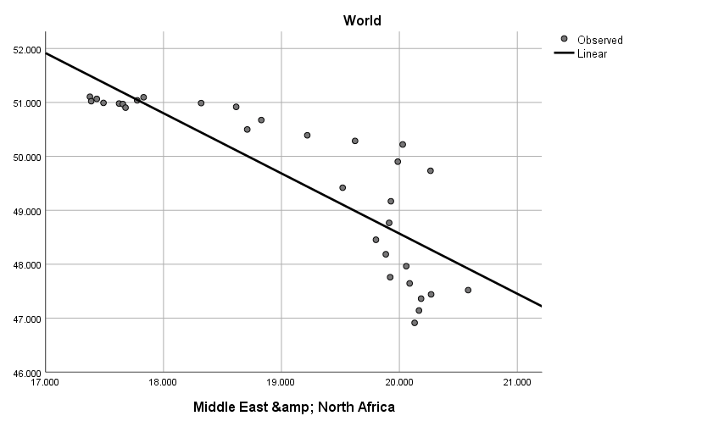
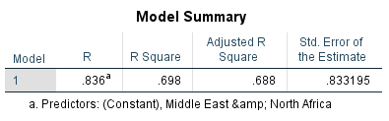
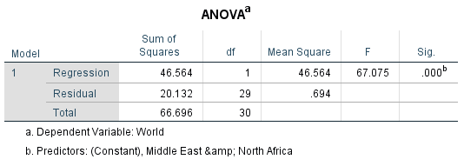

Slide 17
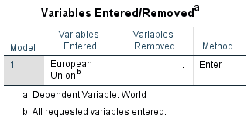
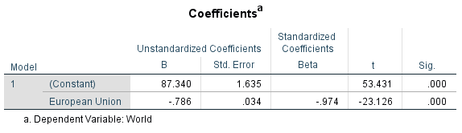
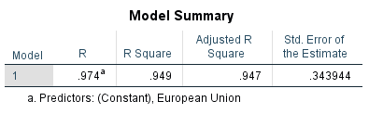
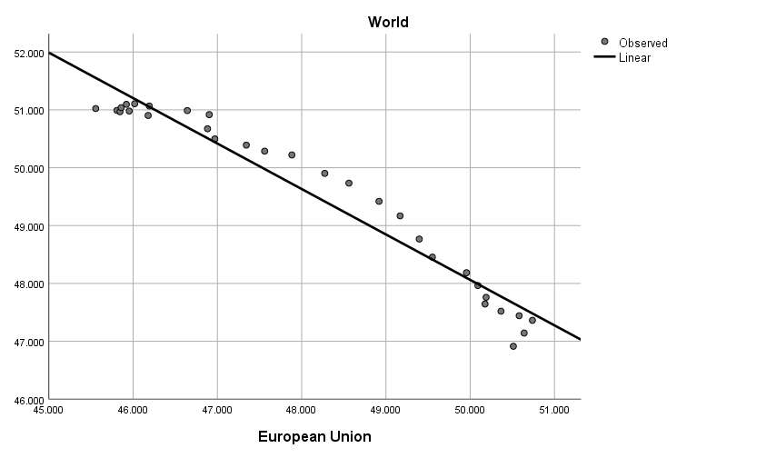
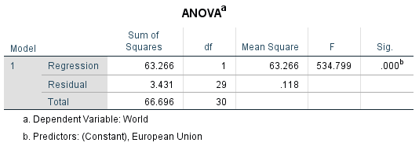

Slide 18
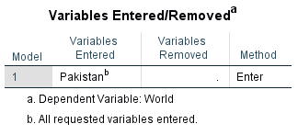
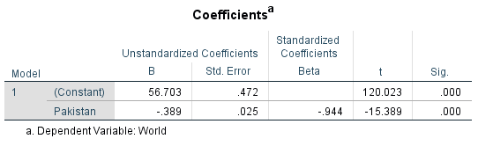
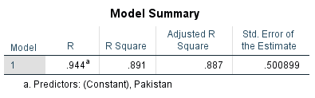
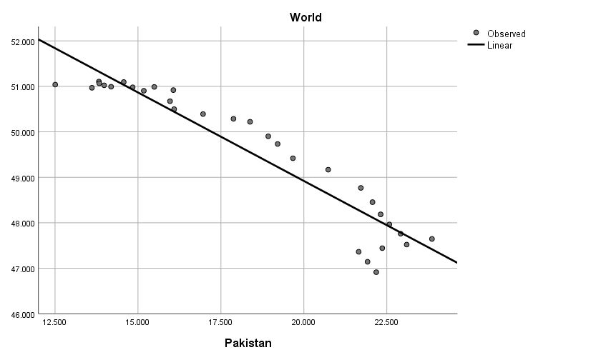
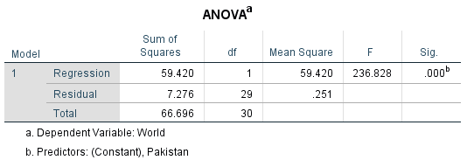

Slide 19
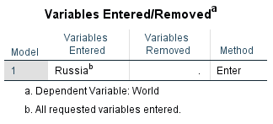

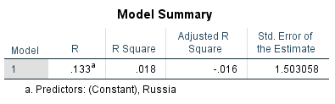
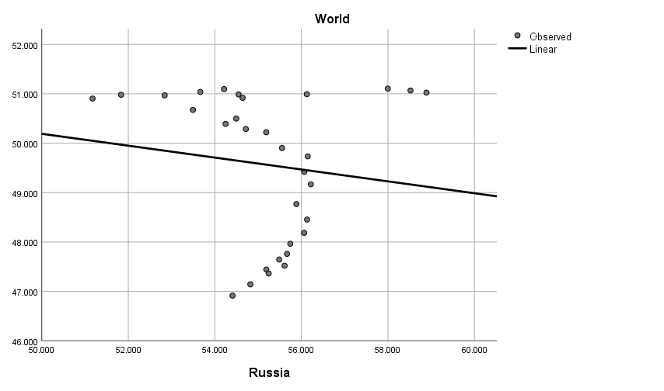


Slide 20






Slide 21






Slide 22






Slide 23






Slide 24




Hypothesis Test(By STUDENT T-Test)
Take t value of world as given value check whether t value of mean satisfy our hypothesis or not.
Our value of t mean/exp. IS More than the value of t world/given.
so the null hypothesis is not acceptable .

Slide 26


Slide 27

United States,
Russia , Israel ,
United Kingdom
Afghanistan,
Middle East &North Africa , Pakistan
European Union
Latin America & Caribbean
South East Asian
China ,
Sub Saharan Africa
Bangladesh
India

Slide 28


Slide 29


Slide 30

BOX-PLOT

Slide 31
Data Analysis/conclusion :-
Afghanistan Vs Bangladesh Vs Pakistan
Three of them are Islamic countries and located in South Asia , Bangladesh has more female labour participation (28%) than Afghanistan (16%) and Pakistan( 18%) because Bangladesh has generated more jobs in the sector of apparel and it is much more stable than Afghanistan and Pakistan. Also , fertility rate of Bangladesh is less than Afghanistan and Pakistan . Early marriages of women is also a Contributing Factor which leads to the high fertility rate .

Slide 32
Middle East – North Africa Vs Israel

Slide 33
What explains low participation in India? The decision of and ability for women to participate in the labour force is the outcome of various economic and social factors that interact in a complex fashion at both the household and macrolevel. Based on global evidence, some of the most important drivers include educational attainment, fertility rates and the age of marriage, economic growth/cyclical effects, and urbanization. In addition to these issues, social norms determining the role of women in the public domain continue to affect outcomes. In India, much of the discussion on the falling trends has focused on four key explanations: 1) rising educational enrolment of young women; 2) lack of employment opportunities; 3) effect of household income on participation; and 4) measurement
“The range of challenges for women and girls echoes across Asia and India - lack of education, access to quality education, digital divide, which limits them from gaining employable skill sets and entering the workforce or establishing an enterprise,” the report said.

